Slide 1
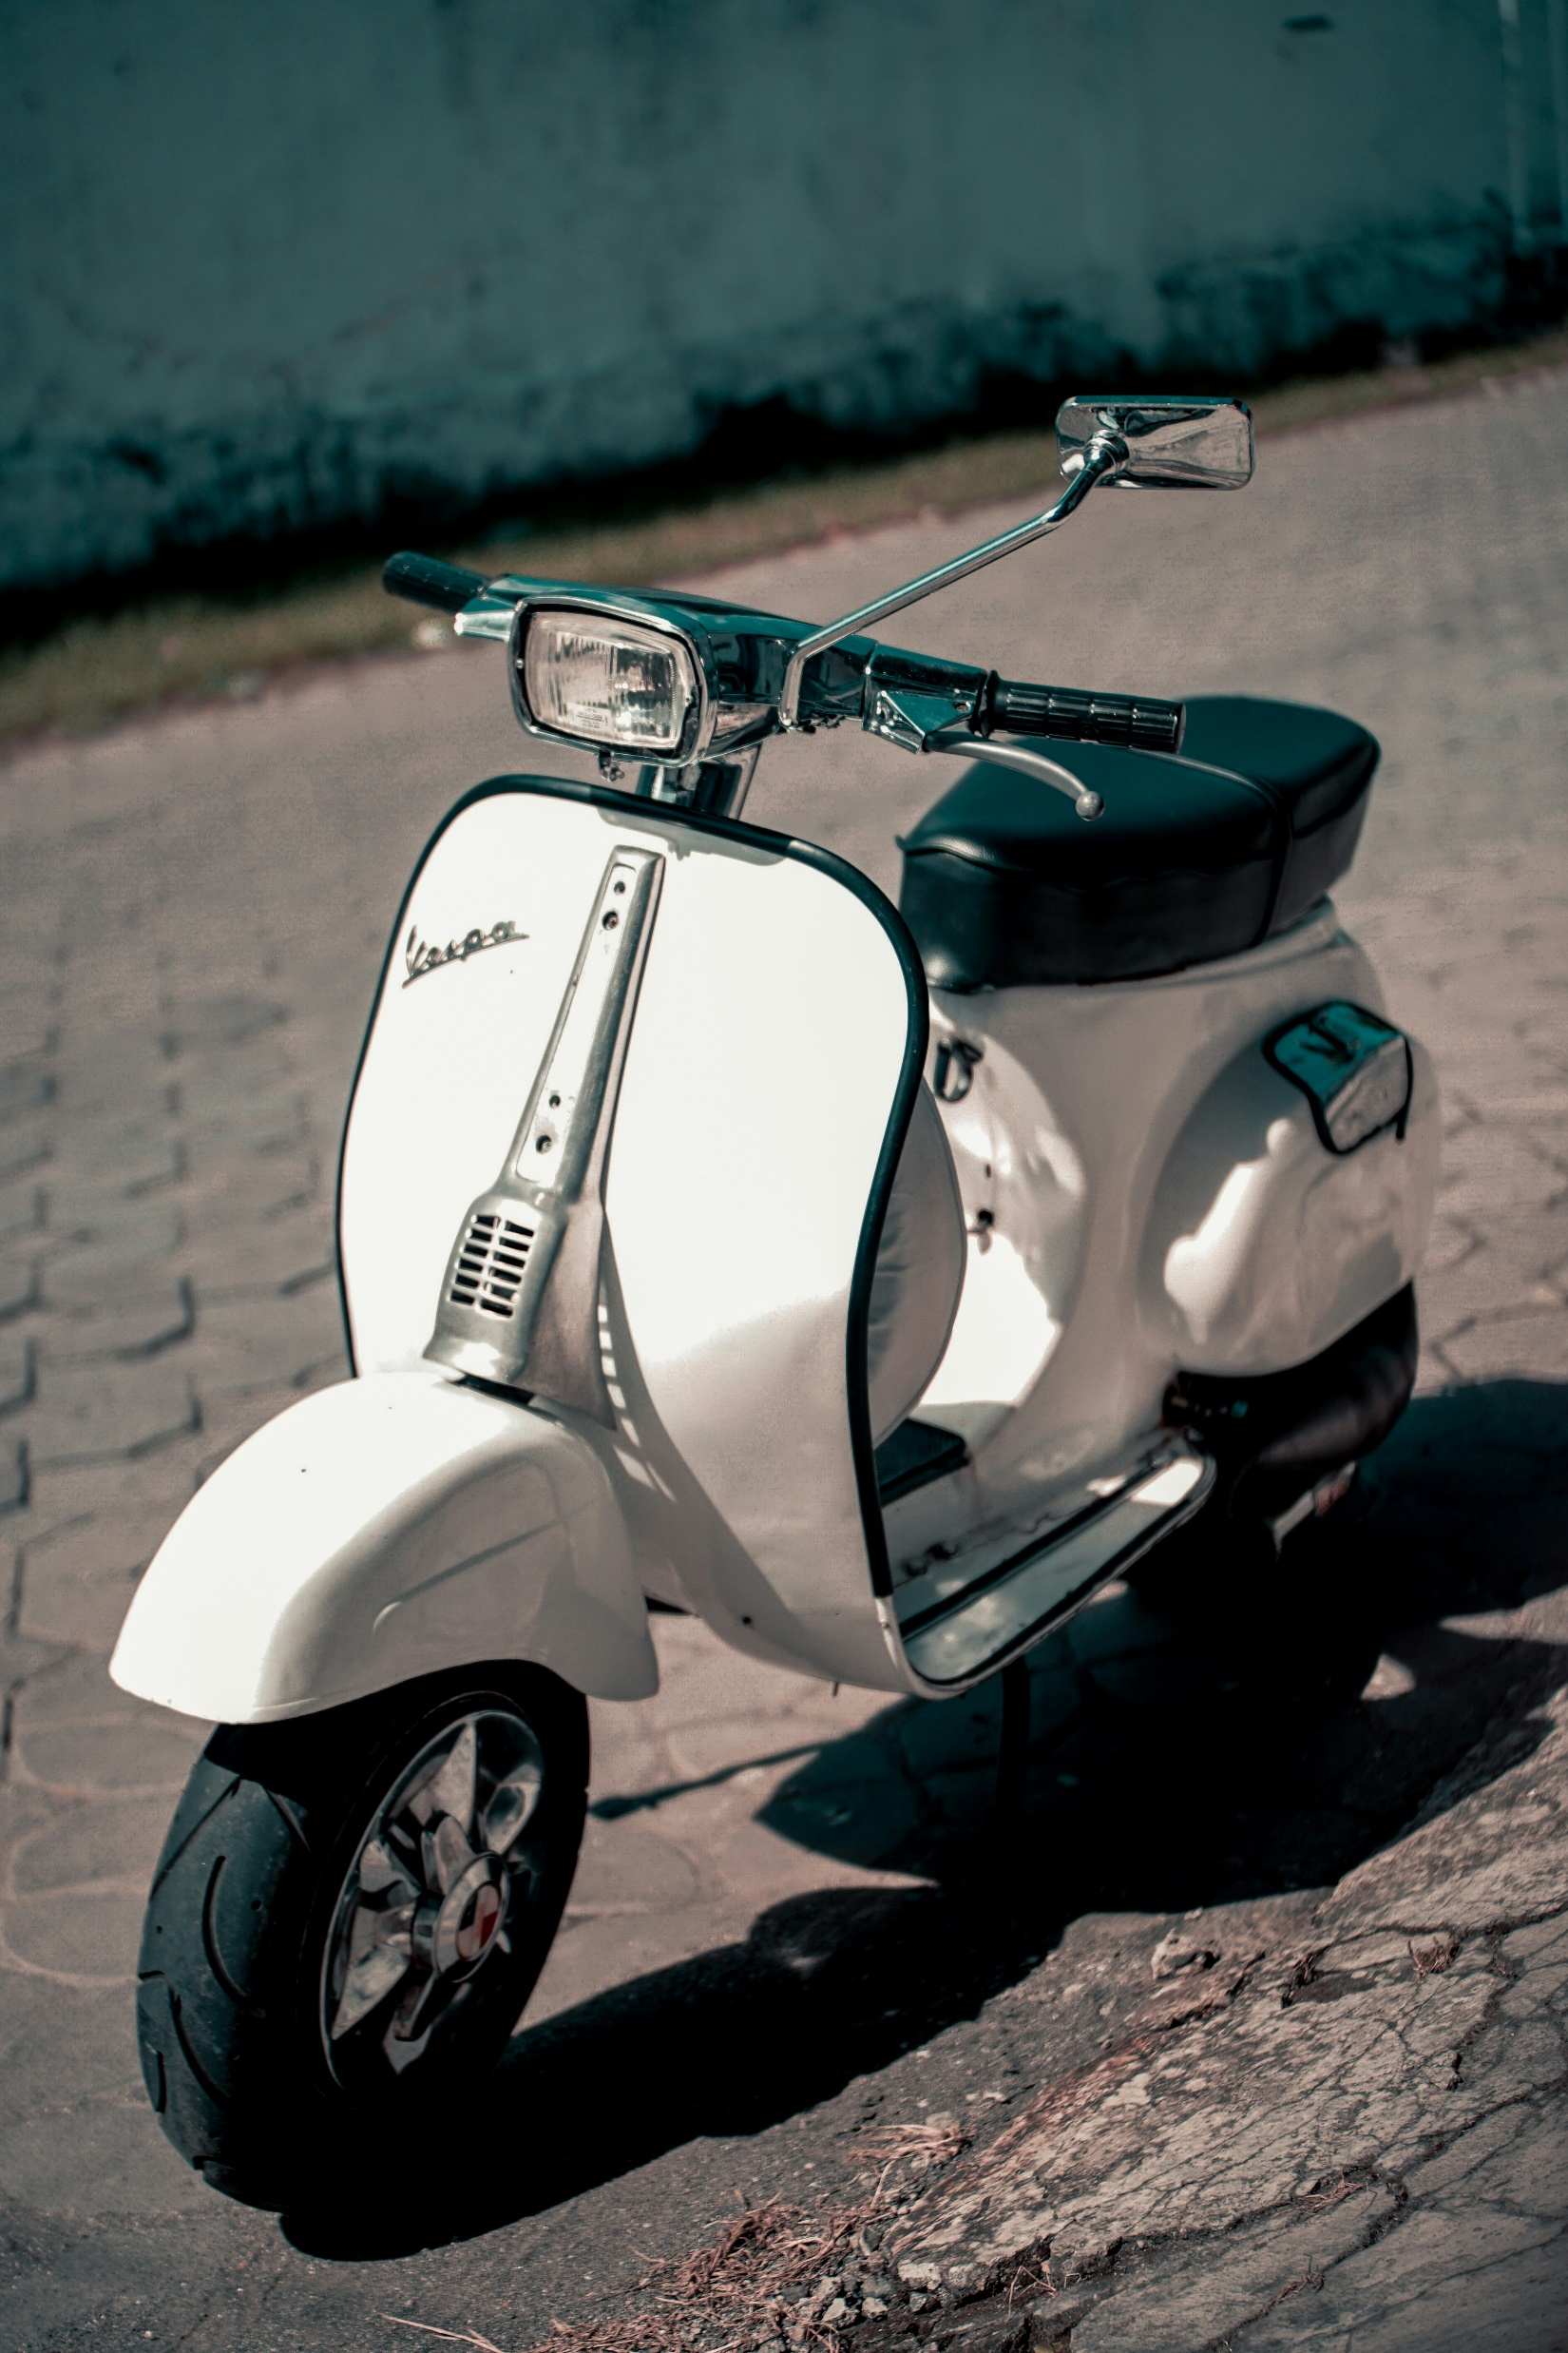
Scooter Rental User Prediction
Empower Your Ride

Slide 2
Objective
In this presentation, I will take you through our end-to-end Machine Learning Operations (MLOps) journey, emphasizing a regression problem designed to predict user engagement in a scooter rental platform.
From the initial stages of Exploratory Data Analysis (EDA) to the deployment of a Streamlit app, we seamlessly integrated MLOps principles at every step, ensuring a robust and scalable solution. Additionally, We harnessed the power of collaborative development on GitHub, emphasizing code review, and collaborative workflows that enriched our project's efficiency and transparency.

Slide 3
Workflow
Development
Created GitHub Repository
New environment for end to end flow
Exploratory data analysis and data pre processing.
Created pipeline
Mlflow tracking
Best model selection
Webapp development
Model deployment
Collaboration
Tracking
Deployment

Slide 4

GitHub
Repository Setup: Established GitHub repository with a requirements.txt file for consistent local environment setup.
Team Member Forks: Team members forked the repository to their GitHub accounts.
Local Cloning: Cloned the forked repository to individual local devices.
Concurrent Development: Simultaneously worked on different project aspects.
Collaboration: Utilized GitHub features for communication, issues, and pull requests.
Merging: Merged individual contributions seamlessly into the main branch.
GitHub

Slide 5
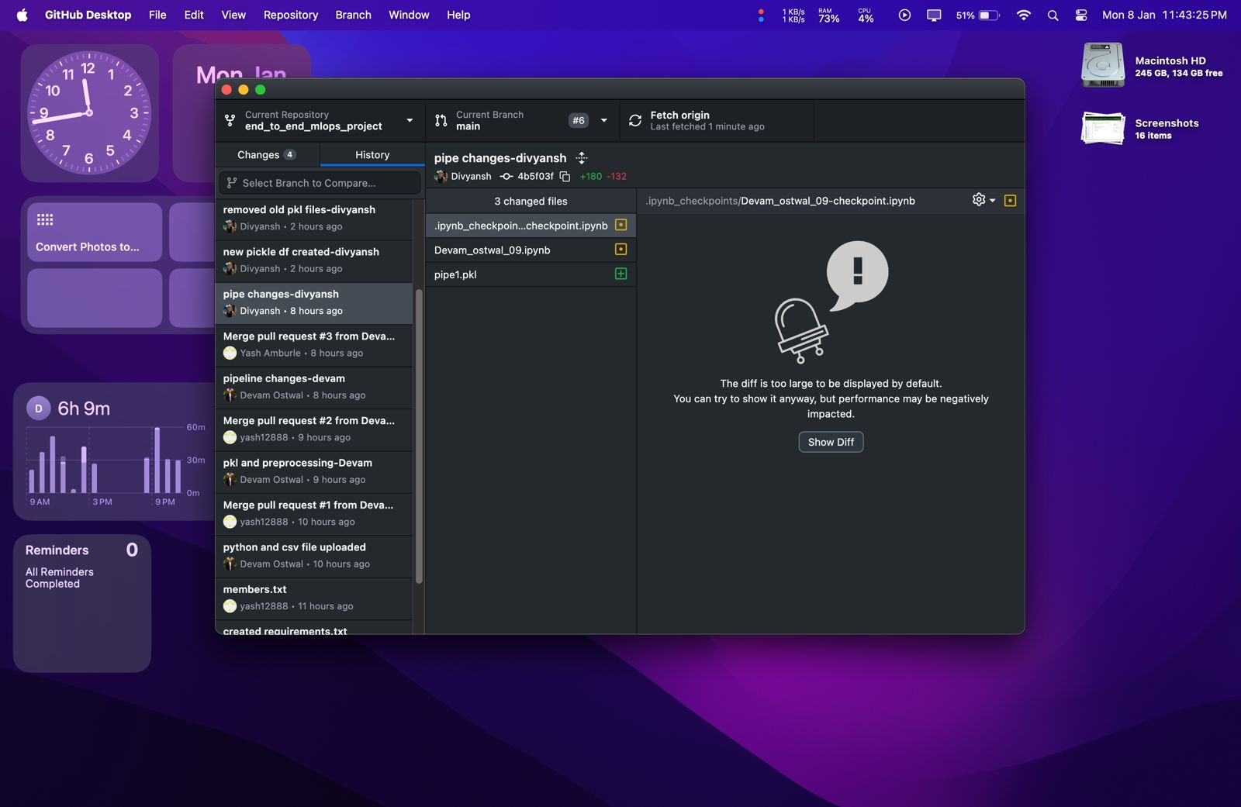
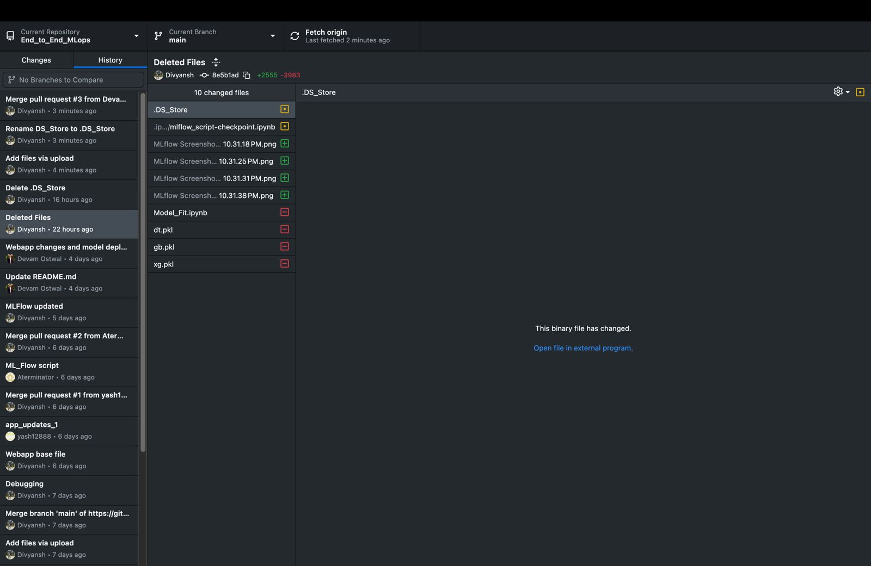
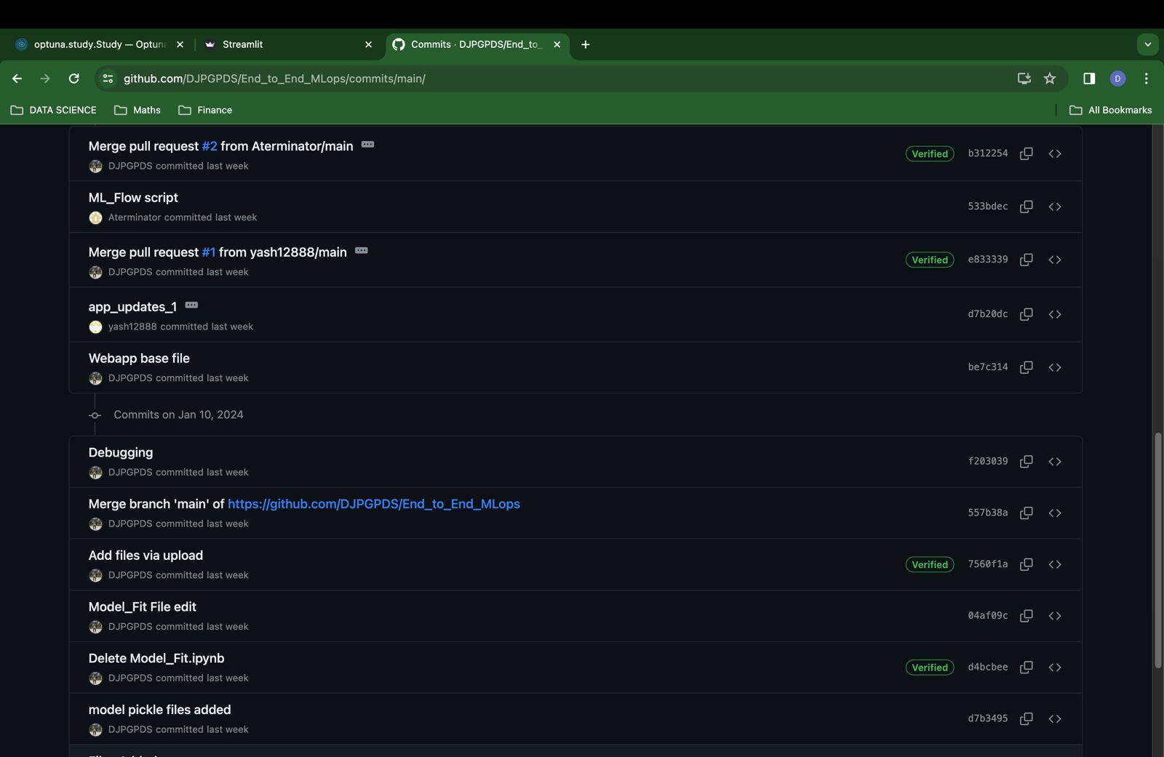
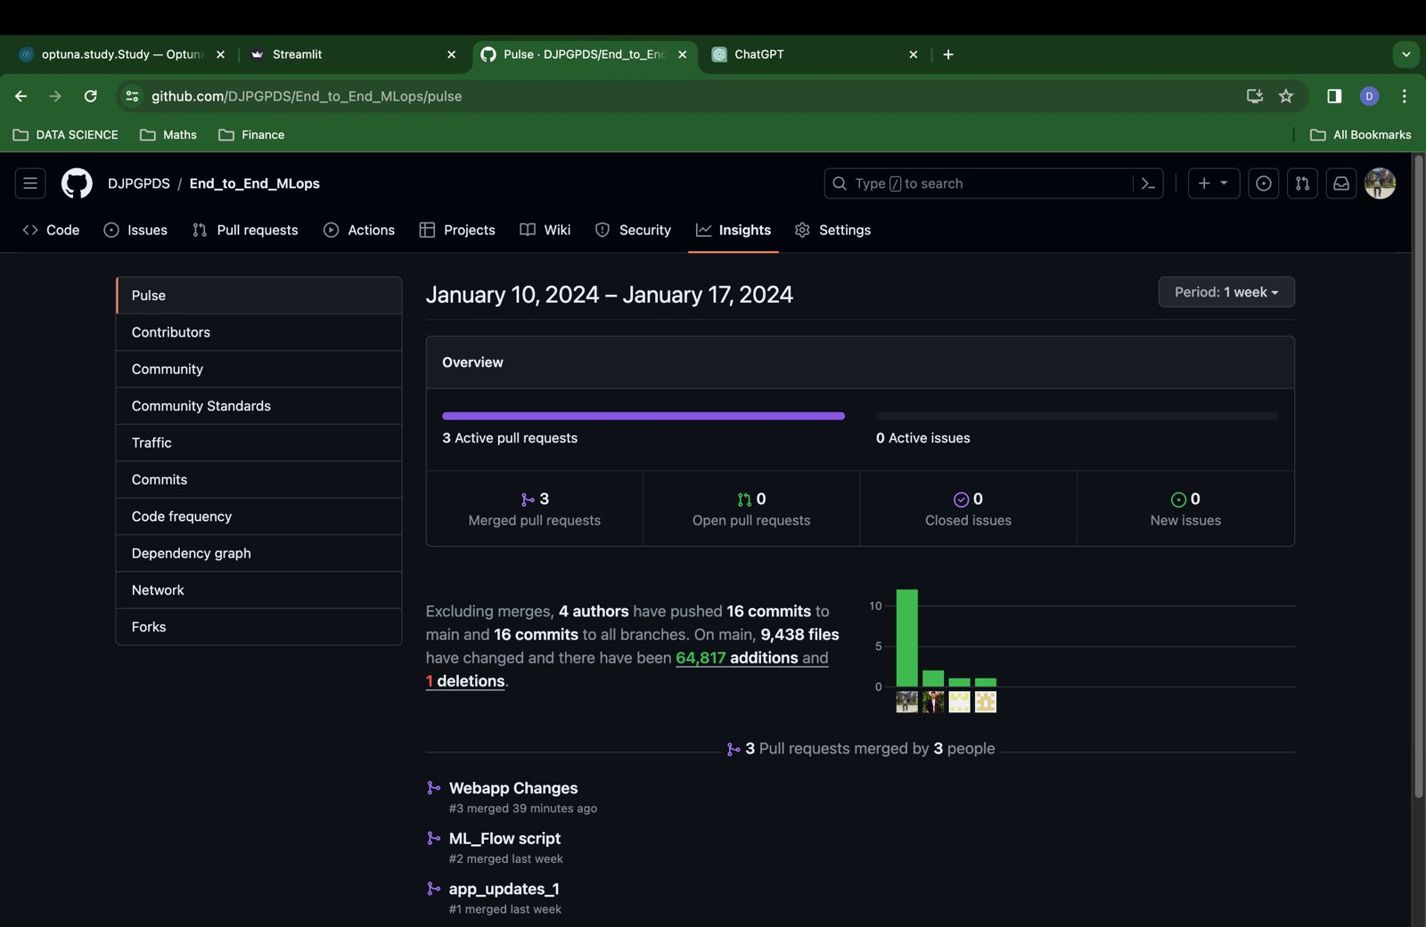

Slide 6
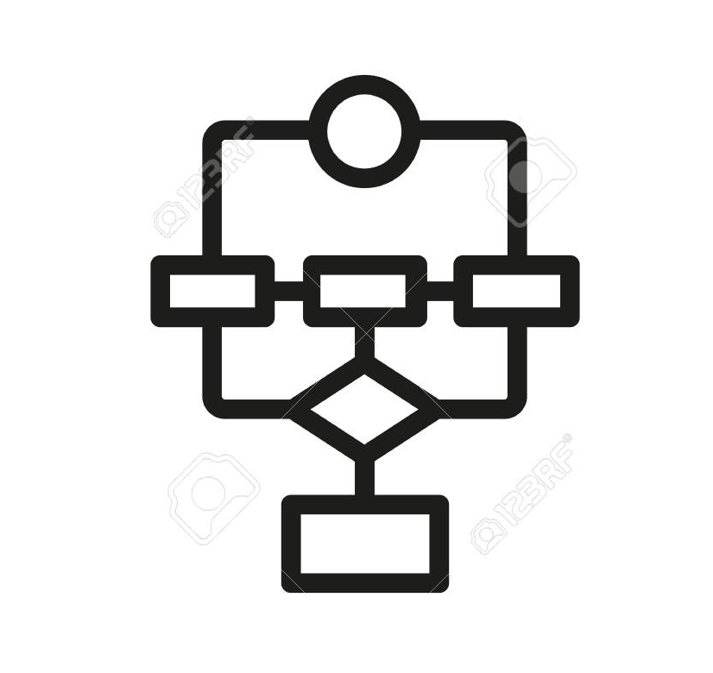
Data Exploration and Preprocessing Pipeline
Segregated Numeric and Categorical Features
Two separate pipelines are defined for numeric and categorical features. For numeric features, missing values are imputed using the median and then scaled using StandardScaler. For categorical features, missing values are imputed using the most frequent value, and one-hot encoding is applied
The Column Transformer is used to combine the numeric and categorical transformers. It specifies that the numeric transformer should be applied to numeric features, and the categorical transformer should be applied to categorical features.
Finally, a complete pipeline is created, which applies Column Transformer to the input data.

Slide 7

Integrated DagsHub with MLflow for Remote Monitoring
Leveraging DAGsHub in conjunction with MLflow,
Our team efficiently monitors and collaborates on model performance.
This integrated solution not only facilitates remote tracking of models but also enhances collaboration, enabling seamless teamwork and comprehensive monitoring of shared projects.
Link to DagsHub to track models performance.
Comparative Analysis for of Model Performance
Employed Mlflow and DagsHub to meticulously track and assess various models.
This approach not only allowed for a comprehensive evaluation of their respective performances but also facilitated insightful comparisons, aiding in the identification of strengths and weaknesses across the models.

Slide 8

MLFlow
Hyperparameter Optimization with Optuna: Utilized Optuna, a hyperparameter optimization framework, to systematically search for optimal hyperparameters for an XGBoost regression model. The optimization was performed with the goal of minimizing the mean squared error (MSE) on the validation set.
Automated Experiment Tracking with MLflow: Implemented MLflow to log and track the entire machine learning experiment. This includes hyperparameters, metrics (MSE, RMSE, MAPE), and model parameters.
Champion Model Identification: Incorporated a custom callback function (champion_callback) within Optuna to identify and print information about the best-performing trial during the optimization process. The information includes trial number, achieved value, and percentage improvement over the previous best value.
Comparison and Logging of Best Model: Compared and logged the best XGBoost model based on the minimum MSE obtained from the Optuna optimization process.

Slide 9
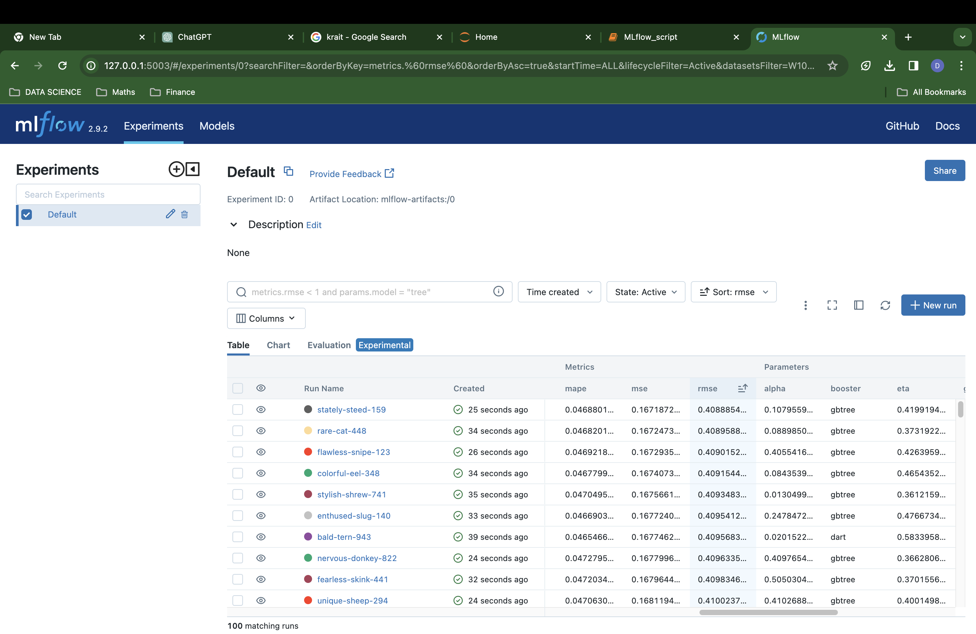
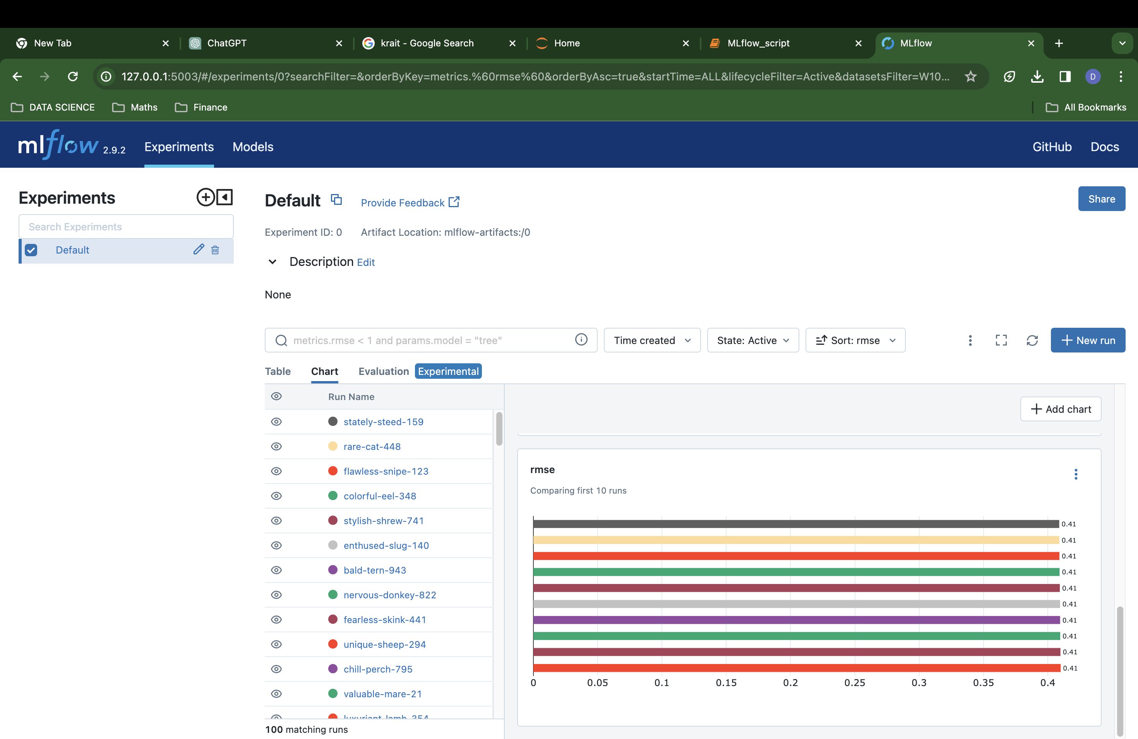
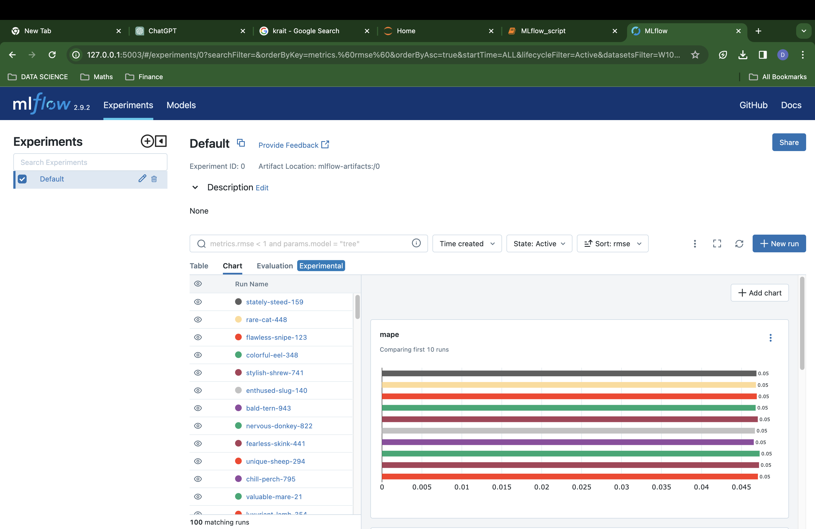
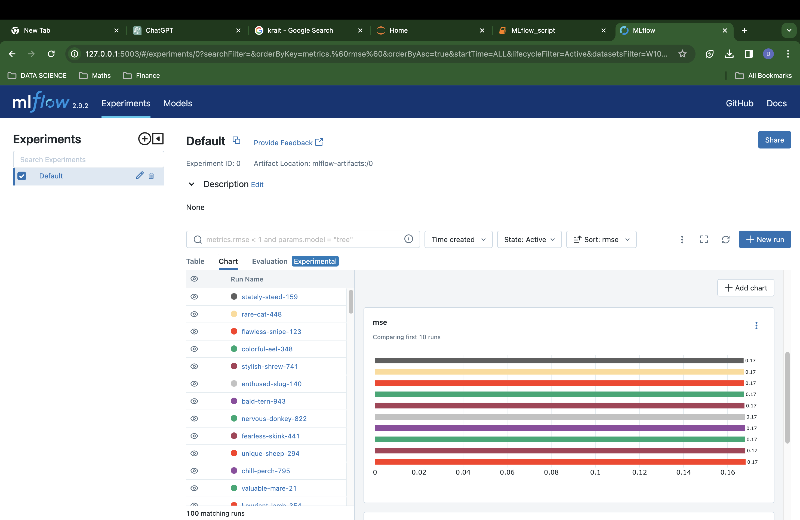

Slide 10

App Development
Developed an end-to-end web application to predict Scooter Rental Users' demand.
Seamlessly integrates machine learning with user-friendly interface using Streamlit.
Employed XGBoost Regressor, a powerful and efficient algorithm for predictive analytics.
Utilized pickle files to encapsulate preprocessing steps, ensuring consistency in data treatment.
Stored the trained XGBoost model using a pickle file for efficient loading and real-time predictions.
Created an interactive UI with Streamlit, allowing users to input data effortlessly.
Link to app: https://scooterrentalusersapp.streamlit.app/

Slide 11
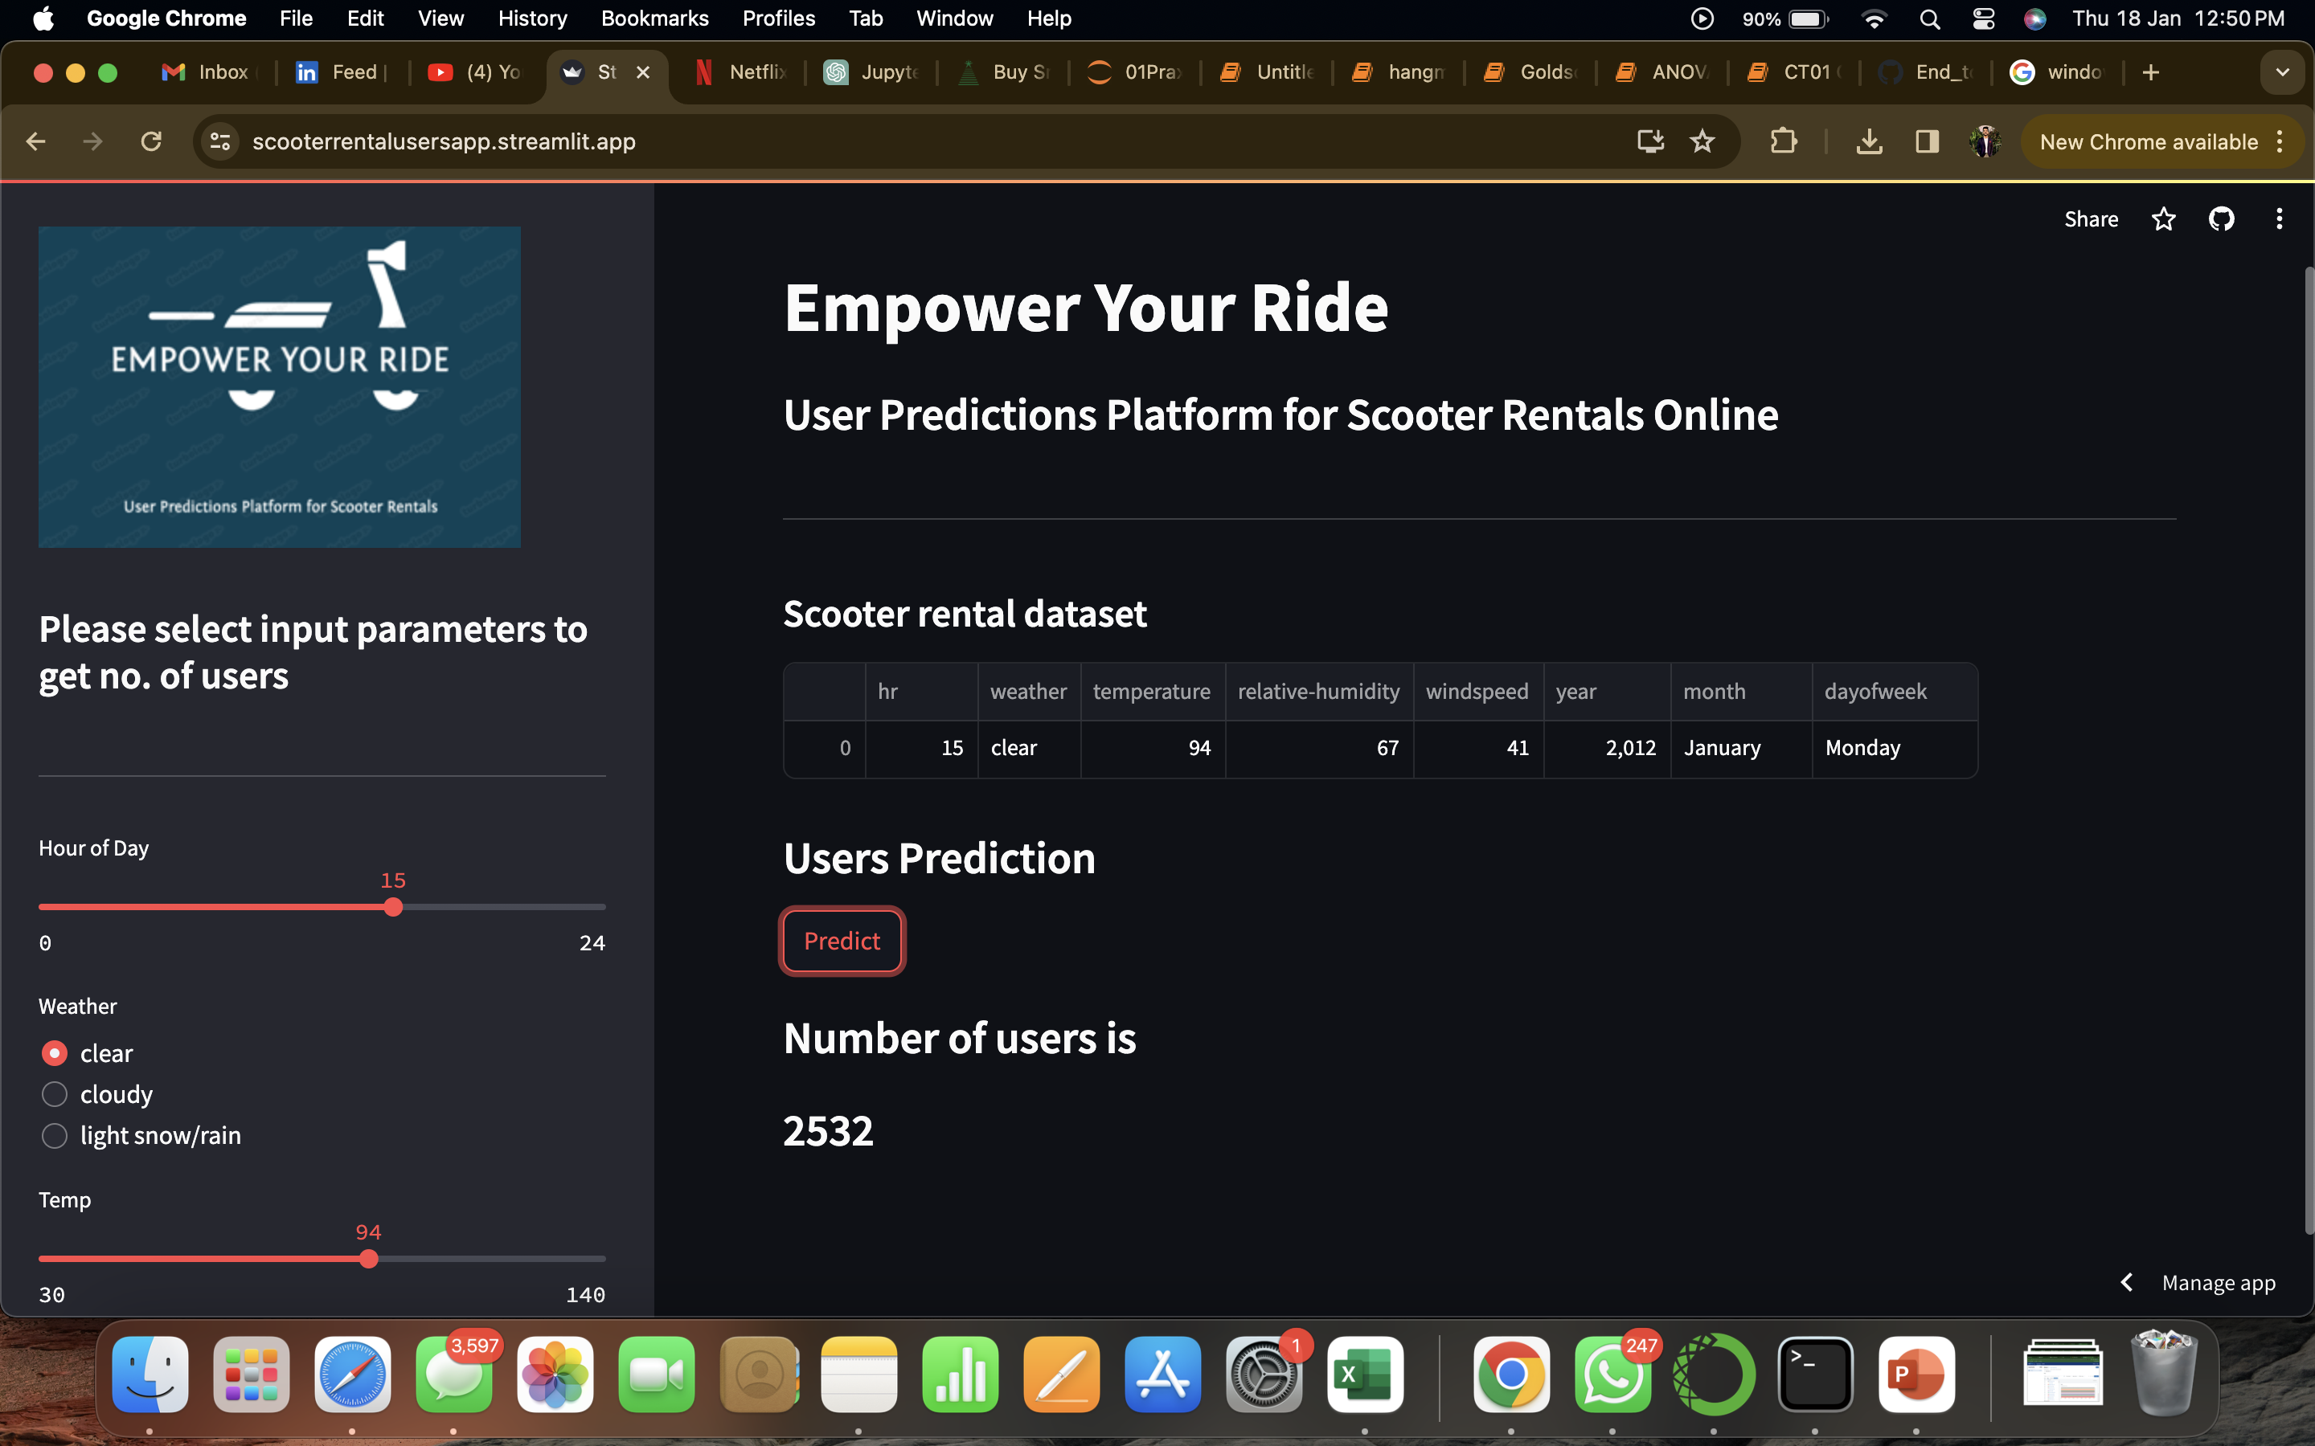

Slide 12

Model deployment using Azure
Retrieved raw training and testing datasets from GitHub, seamlessly integrating Azure AutoML services to train data across three regression models.
Leveraging Azure's compute instance, created endpoints and deployed APIs for model access.
Rigorously tested the deployed model using cloud services like Postman to ensure robust performance and functionality.
The deployed API enables convenient remote access, facilitating seamless testing and collaboration among team members.

Slide 13
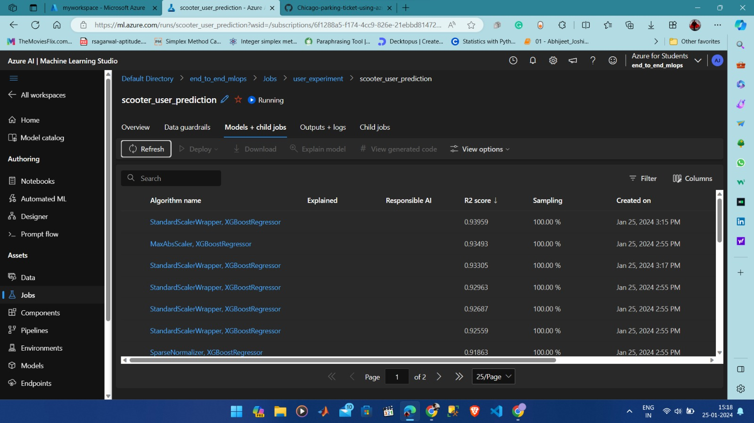

Slide 14
Thank You

